Slide 1
Export Control & Data Security Review Process

Slide 2
Export Compliance & Data Security
Compliance with U.S. export control laws is mandatory
U.S. export laws require protection of export controlled data
Additionally, all DoD awards (and most other Federal awards) require compliance with heightened data security standards for all Controlled Unclassified Information (CUI)
Export controlled information is a sub-category of CUI
Thus, all requirements that apply to a particular award for the protection of CUI will be triggered if the project involves export controlled information (example: DFARS 252.204-7012)

Slide 3
Step 1 PI Completes Award Compliance Form
Once the award comes in and enters the set-up phase within the Division of Sponsored Programs (DSP), the PI will receive a request via UFIRST to complete the award compliance form
PI must complete the award compliance form for all awards (i.e., both grants and contracts)
Depending on the PI’s responses on the compliance form and other risk criteria, UFIRST may automatically send the form to the Division of Research Compliance (DRC) for review

Slide 4
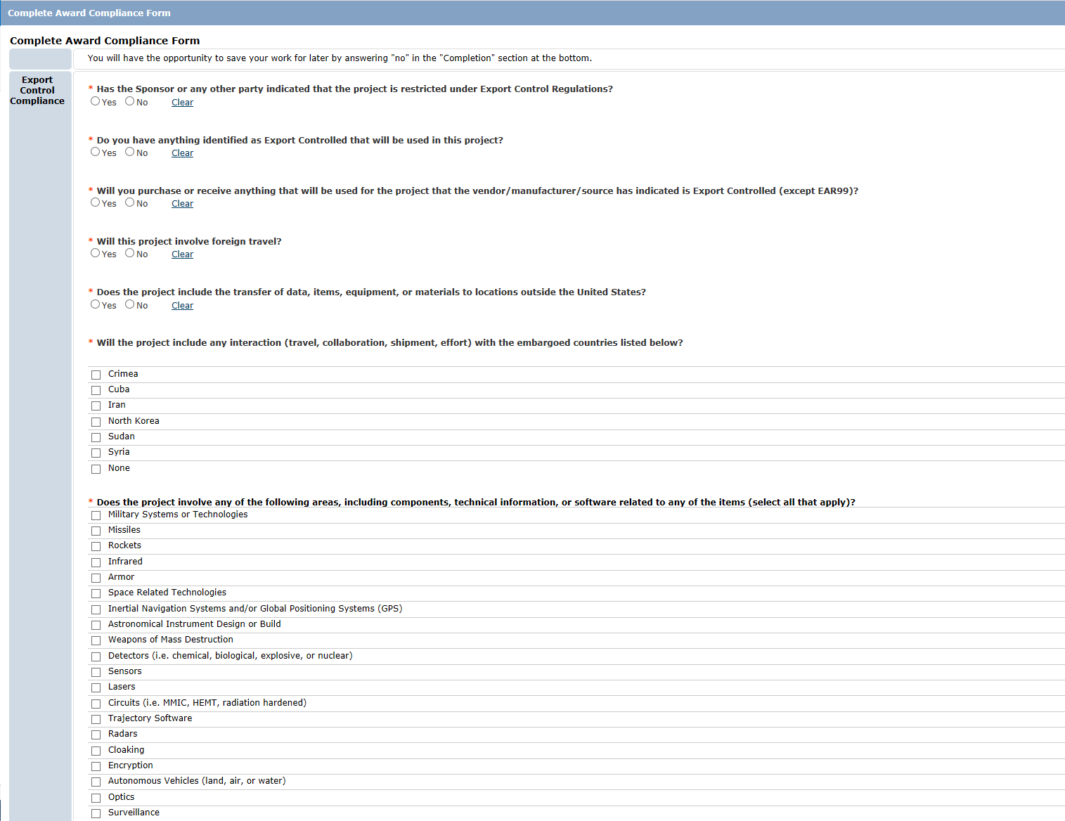
UFIRST Award Compliance Form

Slide 5
Step 2 DRC Review
DRC reviews the award compliance form, scope of work, grant/contract, etc.
Often, DRC will contact the PI to further discuss the scope of work and planned activities
DRC is looking for whether the project involves any export controlled information or equipment
DRC also flags any special data security requirements, such as DFARS 252.204-7012

Slide 6
Step 3 TCP Kick-Off Meeting
If DRC determines that the project involves export controlled information or equipment, DRC will work with the PI to develop a Technology Control Plan (TCP)
TCPs include requirements for physical security and information security of the export controlled data or items
If the award agreement requires heightened data security (i.e., compliance with NIST 800-171), DRC will invite departmental IT and Research Computing to the TCP kick-off meeting

Slide 7
Step 4 Develop Data Security Plan
Departmental IT and Research Computing will work with PI to understand the scope of the project, identify controlled data, and determine best data security approach
Goal is to provide data security that meets the needs of the project and is compliant
DRC will support throughout this process to help identify which data is and is not controlled
Once the data security plan is developed, DRC will include it in the TCP and circulate the TCP for signatures

Slide 8
Step 5 TCP Monitoring
DRC conducts annual reviews of all TCPs
DRC will invite departmental IT and Research Computing to the annual review meetings

Slide 9
Terra DuBois, Director of Research Compliance and Global Support
tdubois@ufl.edu
352-392-9174
http://research.ufl.edu/faculty-and-staff/research-compliance/export-controls.html

